Slide 1
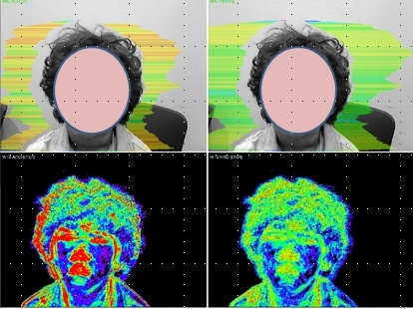
Clinical Application Of VIBRAIMAGE Technology
and System For Screening Of ADHD Children
VIBRASYSTEM

Slide 2
Clinical research condition
Total testees : 110 children
Control group : 8 ~ 16 old
Research group : 60 children diagnosed by EEG
(Cz; theta/beta ratio > 3)
Research are : Seoul, Daegu city area in South Korea
Researching Team : Youngnam University
Seoul National University
VIBRASYSTEM

Slide 3
Clinical research condition
Table 1. Baseline characteristics of the subjects.
 | ADHD group (n = 60) | Control group (n = 50) | P-value*
Age (years) | 11.40 ± 1.90 | 11.32 ± 1.52 | 0.867
Gender
Male | 35 (58.3%) | 25 (50.0%)
Female | 25 (41.7%) | 25 (50.0%)

Slide 4
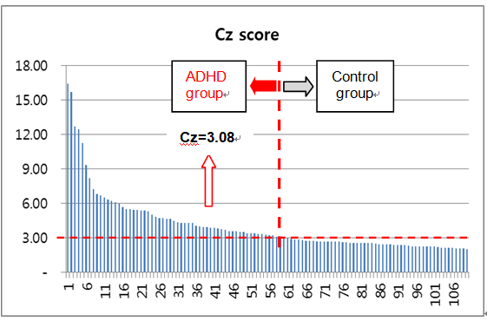
Comparison of mean QEEG TBR(Theta/Beta ratio)
 | ADHD group | Control group
Cz score (Total) | 5.42 ± 2.87 | 2.48 ± 0.25
Male | 5.11 ± 2.65 | 2.43 ± 0.26
Female | 5.85 ± 3.09 | 2.54 ± 0.22
Comparison of Cz score between ADHD and Control group

Slide 5
M comparison between ADHD and Control group
In order to deduce the discriminant, the test sample and the holdout sample were
selected as shown on below table.
They were selected randomly, using random number table.
 | Test sample | Holdout sample | Total
Control group | 37 | 13 | 50
ADHD group | 48 | 12 | 60
 | 85 | 25 | 110
Comparisons of mean (M) value between ADHD and Control group

Slide 6
Predictive VI parameters to discriminate ADHD
Objectives
To verify whether it is possible to diagnose ADHD only using the VI parameters
To find out the discrimination equation.
Mean (M) value comparisons between ADHD and control group for Test sample
Item | Mean (M) between groups |  |  | T-test
 | ADHD group (N =48) | Control group (N = 37) | Mean differentiation | t-value | DF(degree of freedom) | p-value
Aggression (T1) | 54,0 | 41,8 | 12,2 | 10,062 | 83 | 0,0001
Stress (T2) | 224 | 30,7 | -8,3 | -8,366 | 83 | 0,0001
Tension (T3) | 26,3 | 25,9 | 0,4 | 0,198 | 83 | 0,844
Suspect (T4) | 34,4 | 32,4 | 1,9 | 2,446 | 83 | 0,017
Balance (T5) | 70,0 | 72,0 | -1,9 | -1,295 | 83 | 0,199
Charm (T6) | 79,8 | 65,1 | 14,7 | 9,144 | 83 | 0,0001
Energy (T7) | 38,4 | 23,5 | 14,9 | 6,847 | 83 | 0,0001
Self regulation(T8) | 74,3 | 67,8 | 6,5 | 4,247 | 83 | 0,0001
Inhibition (T9) | 19,3 | 19,4 | -0,1 | -0,065 | 83 | 0,948
Neuroticism (T10) | 39,1 | 29,6 | 9,5 | 3,361 | 83 | 0,001

Slide 7
Canonical discriminant function coefficient
The discriminant function derived from discriminant analysis is determined from the number of dependent variable groups and from the number of independent variables.
Canonical discriminant function coefficients
 | Standardized | Unstandardized
Aggression(T1) | 0,208 | 0,038
Stress (T2) | -0,361 | 0,079
Tension(T3) | -0,406 | -0,046
Suspect (T4) | 0,734 | 0,202
Balance (T5) | 0,230 | 0,034
Charm (T6) | 0,791 | 0,108
Energy (T7) | 0,109 | 0,011
Self-regulation (T8) | -0,530 | 0,076
Inhibition (T9) | -0,040 | 0,006
Neuroticism (T10) | 0,186 | 0,014
Intercept | None | 10,950

Slide 8
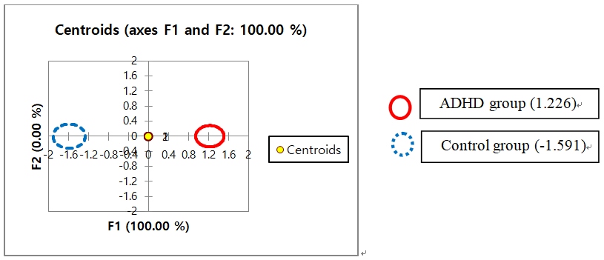
Centroids and Functions at the centroids
The median for the ADHD group is 1.226, and for the control group, -1.591.
If the value calculated from the discriminant function of the unstandardized
coefficients close to 1.226, the case would be diagnosed as ADHD,
2) if the value is close to -1.591, the case would be diagnosed as normal.

Slide 9
Confusion matrix for test sample and holdout sample
The accuracy of the discriminant function was evaluated based on the correctness
of classification of the confusion matrices of both estimation sample and holdout sample.
1) The correctness of classification of the test sample from this study is 92,9 %,
2) The correctness of classification of the holdout sample was 92,3 %.
to group | Diagnosed ADHD |  | Diagnosed normal |  | Total |  | % correct
Sample | Test sample | Holdout sample | Test sample | Holdout sample | Test sample | Holdout sample | Test sample | Holdout sample
ADHD group | 48 | 12 | 0 | 0 | 48 | 12 | 100,0 % | 100,0 %
Control group | 6 | 2 | 31 | 11 | 37 | 13 | 83,78 % | 84,62 %
Total | 54 | 14 | 31 | 11 | 85 | 25 | 92,94 % | 92,31 %

Slide 10
Discussion and Conclusion
A study conducted by Snyder and Hall reported 94 % sensitivity and specificity in predicting ADHD when the TBR effect size was 3.08.
The mean TBR for ADHD group was 5.4 and for the control group was 2.5.
Despite the discriminant validity of QEEG TBR, this study has some limitations.
We cannot differentiate the presence of ADHD only with the abnormally elevated TBR using QEEG.
Through discriminant analysis on these variables, using M score as input
functions, 92.94 % accuracy rate was obtained in diagnosing ADHD.
A total of 7(seven) variables that were M (mean) values of 10 Vibraimage
parameters
– aggression (T1), stress (T2), suspect (T4), charm (T6), energy (T7),
self-regulation (T8), neuroticism (T10) –
had p-value lower than 0.017.
Based on these results, it is expected that a more advanced discriminant
analysis for ADHD which is easy to use would be developed.

Slide 11
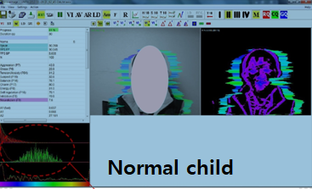
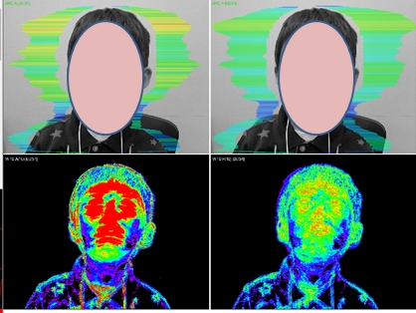
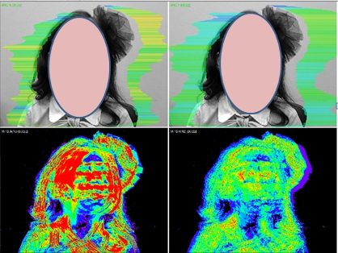
ADHD image example
ADHD

